Slide 1
Chatbot For Journal Paper Publication System
CSE7301 Capstone Project
Review-4
Batch Number: CBC-G11
Under the Supervision of,
Dr. Nagaraja S R
Associate Professor with Selection Grade
School of Computer Science and Engineering
Presidency University
ROLL NO | STUDENT NAME
20221LCC0004 20211CCS0110 20211CCS0092 20221LCC0001 | SURYA SAI PRAKASH Y V BHARATH S MANJUNATHA B CHANDAN H
Name of the Program: B TECH
Name of the HoD: Anandaraj S P
Name of the Program Project Coordinator: Dr. Sharmasth Vali Y
Name of the School Project Coordinators: Dr. Sampath A K / Dr. Abdul Khadar A / Mr. Md Ziaur Rahman

Slide 2
Introduction
This project introduces a Chatbot-Based Paper Publication System for efficient research paper management.
It allows authors to submit papers, track status, and receive updates through a simple chatbot interface.
The system currently supports local file storage with scope for database integration and user authentication.
It enhances the submission and review process for both authors and administrators.
This initiative aligns with Sustainable Development Goals by promoting quality education, innovation, and reduced inequalities.

Slide 3
Literature Review
Traditional paper submission systems often involve manual review processes and lack real-time interaction.
Recent studies show that AI-powered chatbots enhance user engagement and streamline data collection.
Literature also highlights the effectiveness of automated status tracking in academic publishing platforms.
Integration of chatbots in research workflows promotes accessibility, speed, and transparency.
This project builds upon these findings to offer a user-friendly, intelligent interface for paper publication.

Slide 4
Proposed Method
Design a web-based portal with a React frontend and Node.js/Express backend for paper submission.
Implement local file storage initially, with future support for MongoDB database integration.
Develop a smart chatbot interface to assist users with submission status and queries.
Enable user roles for authors and admins with authentication for secure access.
Plan to display submitted papers dynamically on conference and archive pages.

Slide 5
Objectives
Assist authors in paper submission
Provide information on journal guidelines
Track submission status
Facilitate reviewer
selection and communication
Support editorial workflow
Answer frequently asked questions (FAQs)
Provide revision and resubmission guidance
Improve user experience and accessibility
Provide multilingual support
Collect feedback and improve services

Slide 6
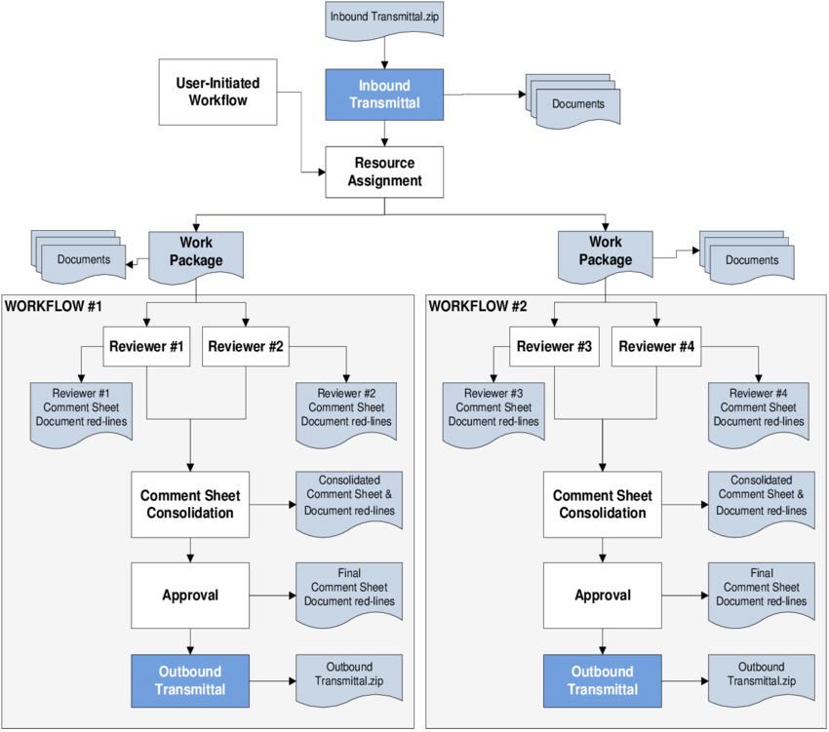
ARCHITECTURE

Slide 7
Methodology
Requirement Analysis
Design and Planning
Platform and Technology
Selection Natural Language Processing (NLP)
Integration Dialogue Management Backend
Integration Testing and Validation
Deployment Monitoring and Maintenance

Slide 8
Timeline of the Project (Gantt Chart)
Review 0
Review 1
Review 2
Review 3
Review 4
Review
Initiation
Planning
Designing
Testing
Title Selection, Github repo creation,
Requirement Gathering
Requirement Analysis, Setting up of required environments
Data Integration & Security Implementation
Testing & Validation
Checking for error and debugging to check for bugs
Final Viva Voce

Slide 9
Expected Outcomes
Implementing the proposed system significantly enhance the efficiency
Streamlined paper submission process
Faster response to author and reviewer queries
Real-time tracking of manuscript status
Reduced workload for editorial staff
Improved communication between authors, reviewers, and editors
Increased accuracy in handling FAQs and guidelines
Multilingual support for diverse user base
Collection of actionable feedback for process improvement
Enhanced user experience for authors and editors
Higher overall efficiency in journal publication workflow

Slide 10
Conclusion
The chatbot improves efficiency by automating routine tasks and queries in the journal publication process.
It enhances user experience by providing real-time updates and clear guidance to authors and editors.
The system reduces the workload of editorial staff and speeds up communication.
Multilingual support and feedback collection ensure accessibility and ongoing improvement.
Overall, the chatbot streamlines the publication workflow, making the system more responsive and user-friendly.

Slide 11
References (IEEE Paper format)
1. IEEE Standard for System and Software Verification and Validation (IEEE Std 1012-2024)
2. IEEE Recommended Practice for Software Requirements Specifications (IEEE Std 830-2025)
3. -Fielding, R.T., "Architectural Styles and the Design of Network-based Software Architectures," 2023(REST dissertation)
4. IEEE Paper on Microservices Architecture (DOI: 10.1109/ICACCI.2016.7732187)
5. "Open Journal Systems: A Complete Guide to Online Publishing" (Public Knowledge Project)

Slide 12
SDG GOALS
SDG 8 – Decent Work and Economic Growth
Promote sustained, inclusive, and sustainable economic growth, full and productive employment, and decent work for all.
➤ Student innovations can boost local economies by improving tourism services, promoting
entrepreneurship, and creating job opportunities in the travel sector.
SDG 9 – Industry, Innovation, and Infrastructure
Build resilient infrastructure, promote inclusive and sustainable industrialization and foster innovation.
➤ Encouraging tech-based travel solutions (apps, smart tours, digital platforms) directly supports
innovation and modern infrastructure in tourism.
SDG 11 – Sustainable Cities and Communities
Make cities and human settlements inclusive, safe, resilient, and sustainable.
➤ Tourism innovations can improve urban tourism planning, preserve cultural heritage, and manage tourist flows for sustainable development.
SDG 12 – Responsible Consumption and Production
Ensure sustainable consumption and production patterns.
➤ Innovations by students can focus on eco-friendly tourism, reducing environmental footprints, and encouraging responsible tourist behavio

Slide 13
GITHUB REPOSITORY
Surya20221LCC0004/Paperpal

Slide 14
Thank You

